Slide 1
동탄 L3블럭 복합시설 신축현장
2017.11.22
신석주

Slide 2
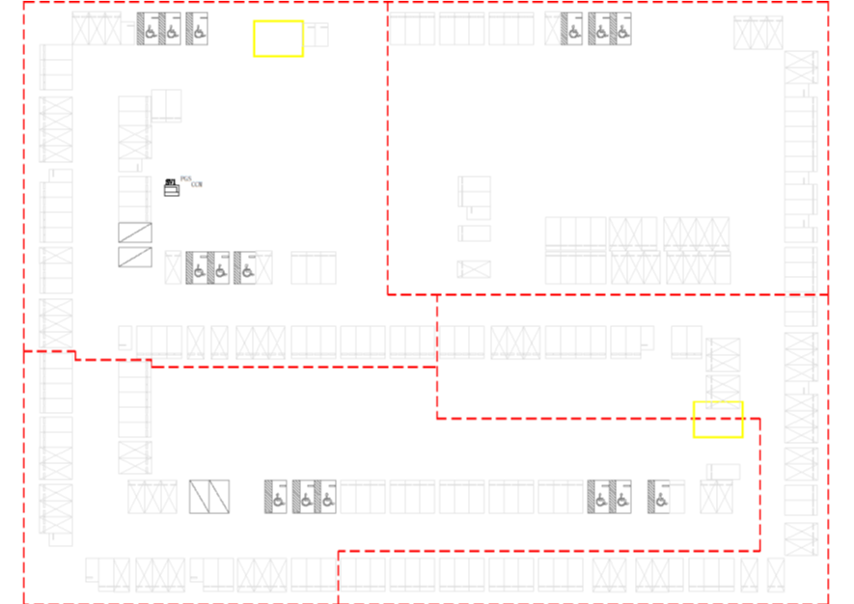
지하 1층
SCM2
SCM1
SCM4
SCM3

Slide 3
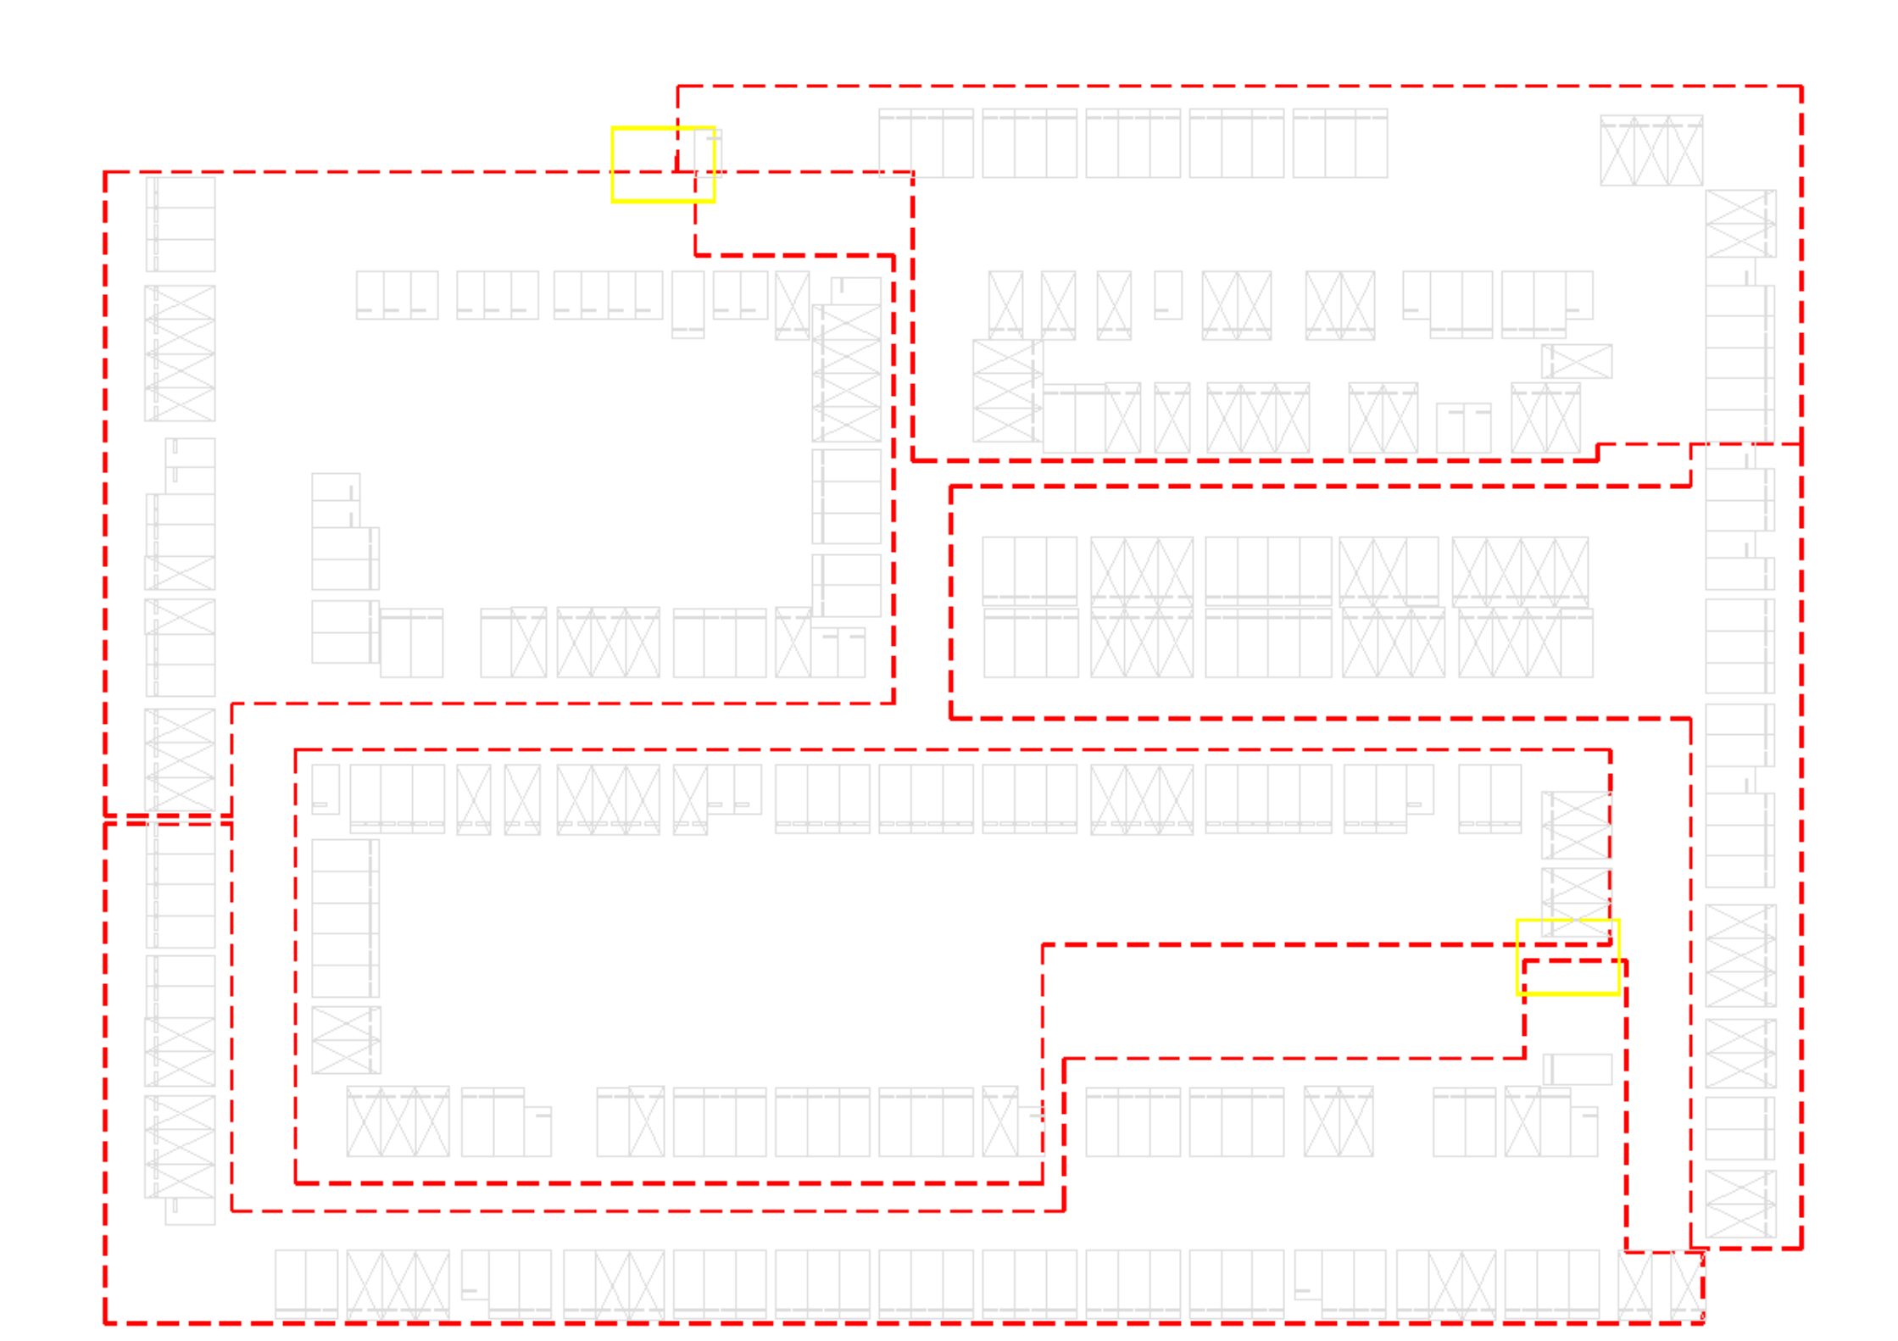
지하 2층
SCM6
SCM5
SCM7
SCM8
SCM9

Slide 4
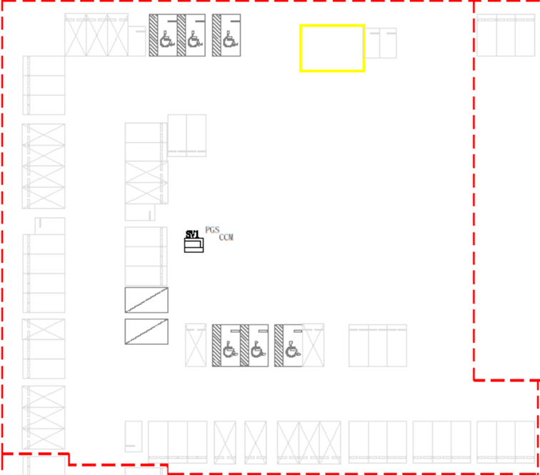
지하 1층
<USM>
65
9644~
~9708
SCM1
9650
9646
9644
9655
9708
9705
9660
9700
9665
9695
9690
9689
9670
9675
9680
9685

Slide 5
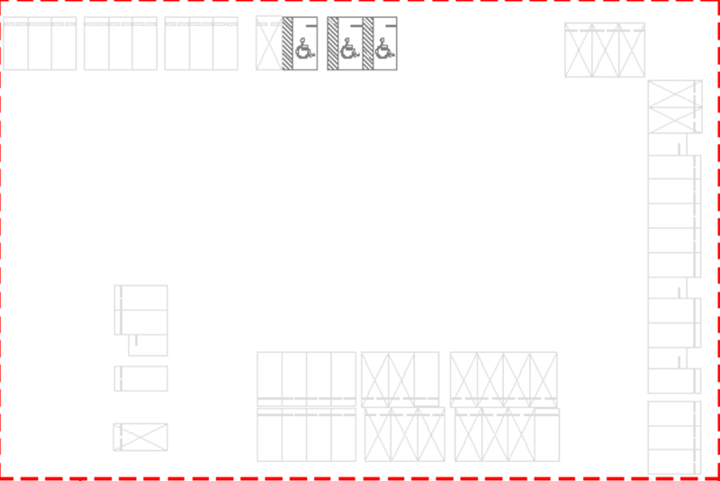
지하 1층
<USM>
59
9709~
~9767
SCM2
9709
9710
9715
9720
9725
9730
9756
9755
9735
9757
9760
9765
9767
9752
9751
9745
9741
9750
9740

Slide 6
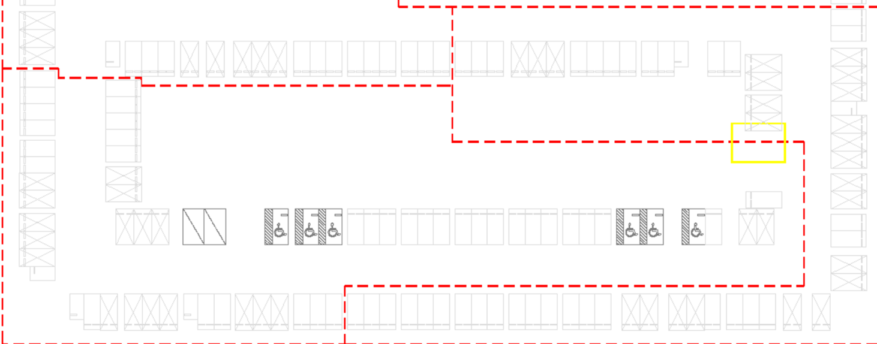
SCM4
지하 1층
<USM>
59
9832~
~9890
<USM>
64
9768~
~9831
SCM3
9851
9832
9835
9840
9845
9847
9768
9795
9855
9770
9850
9800
9860
9775
9831
9805
9810
9815
9820
9825
9830
9865
9780
9785
9790
9794
9890
9885
9880
9875
9870
9866

Slide 7
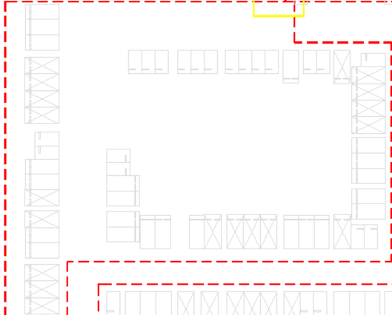
9891
지하 2층
<USM>
61
9891~
~9951
SCM5
9951
9937
9950
9945
9940
9895
9935
9909
9900
9910
9930
9928
9915
9920
9925
9927
9905
9908

Slide 8
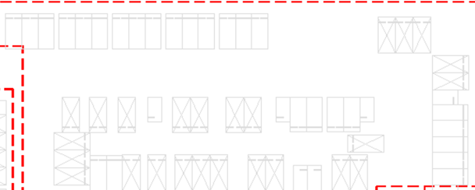
지하 2층
<USM>
57
9952~
~10008
SCM6
9952
9955
9960
9965
9969
9970
9995
10000
10005
10007
10008
9975
9991
9990
9985
9980
9978
9977

Slide 9
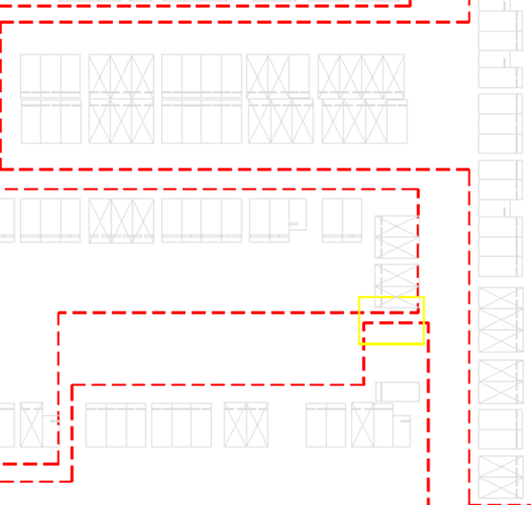
지하 2층
<USM>
57
10009~
~10065
10043
SCM7
10045
10009
10020
10010
10015
10025
10042
10040
10035
10030
10026
10050
10055
10060
10065

Slide 10
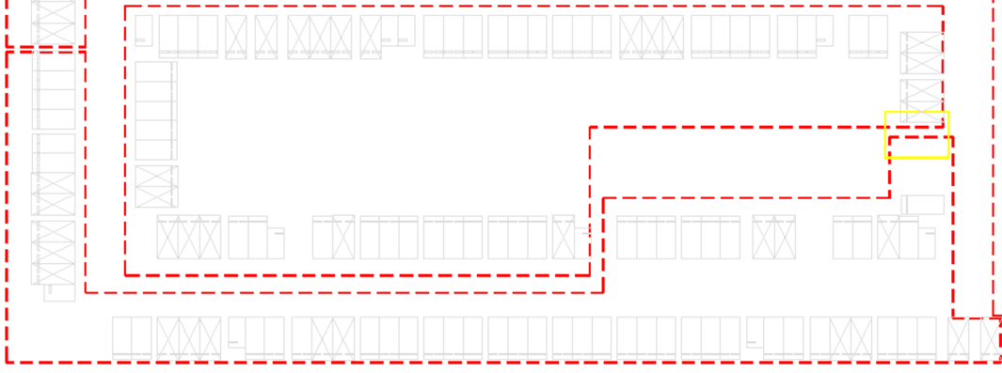
<USM>
63
10066~
~10128
SCM8
지하 2층
10102
10100
10095
10090
10085
10080
10075
10070
10194
10103
10105
10066
10190
10142
10110
10115
10120
10125
10128
10130
10129
10135
10139
10141
10185
10140
10183
10182
10180
10175
10170
10165
10160
10155
10150
10145
10143
<USM>
66
10129~
~10194
SCM9

